Slide 1
Lecture 1 3D Modeling and Animation Assoc.Prof.Dr. Hossam Mahmoud Moftah Associate professor – Faculty of computers and artificial intelligence– Beni-Suef University

Slide 2
Chapter 1 3D Animation Overview
Defining 3D modeling and animation
3D animation industries
The history of 3D animation
2D Animation vs. 3D Animation

Slide 3
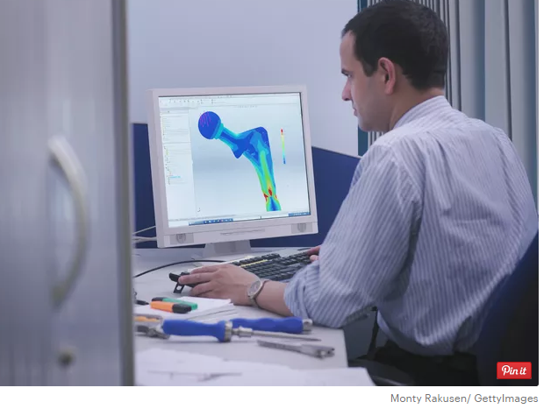
Defining 3D modeling
3D modeling definition: 3D modeling is the process of creating a 3D representation of any surface or object by manipulating polygons, edges, and vertices in simulated 3D space.

Slide 4

Defining object and surface
Object : In computer graphics, an object refers to an item within a graphic.
Surface: It is the portion or region of the object that can first be perceived by an observer using the senses of sight and touch.

Slide 5
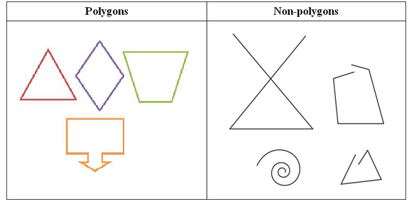
Defining polygons
Polygons definition: A polygon is a closed plane figure made up of 3 or more line segments.
Examples: Triangles, quadrilaterals, pentagons, and hexagons are all examples of polygons..

Slide 6
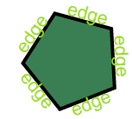
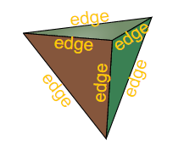
Defining Edges
Edges definition: For a polygon: A line segment on the boundary joining one vertex (corner point) to another.

Slide 7
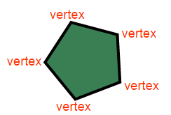
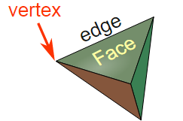
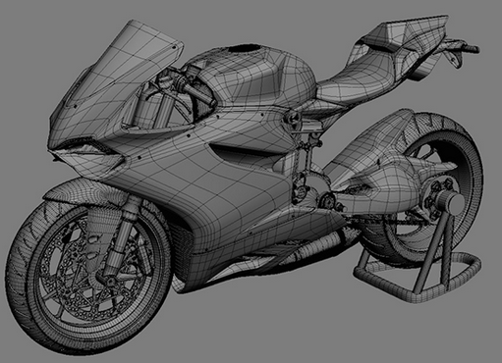
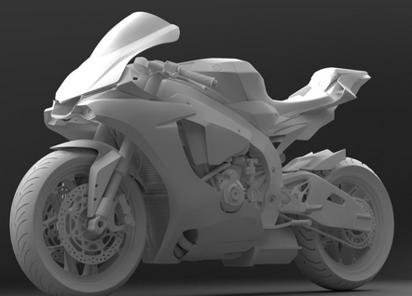
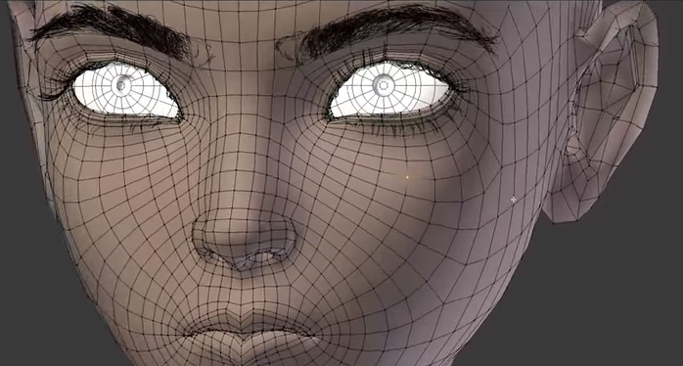
Defining vertices
Vertices definition: A vertex is a corner.
An edge is a line segment between faces.
A face is a single flat surface.

Slide 8
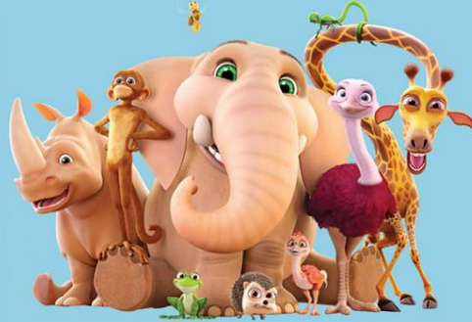
Defining 3D animation
3D animation definition: Animating objects that appear in a three-dimensional space.
3D animation, which falls into the larger field of 3D computer graphics, is a general term describing an entire industry that utilizes 3D animation computer software and hardware in many types of productions.
Adapted from Andy Beane: 3D animation essentials 2012 by John Wiley & Sons, Inc.,

Slide 9
3D animation industries
3D animation is used in three primary industries:
Entertainment
Scientific
Other
Adapted from Andy Beane: 3D animation essentials 2012 by John Wiley & Sons, Inc.,

Slide 10
Entertainment
Entertainment includes :
film,
television,
video games,
and advertising—each of which has subfields within it.
Adapted from Andy Beane: 3D animation essentials 2012 by John Wiley & Sons, Inc.,

Slide 11
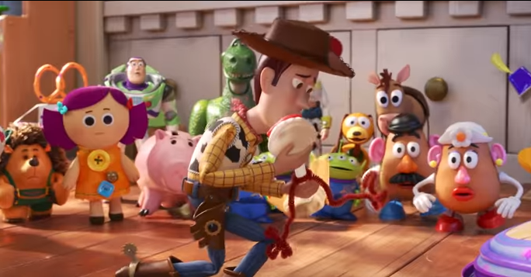
Film
Film: Two primary types of films are created in the 3D animation realm:
Fully animated Films
In fully animated films, all the visual elements onscreen are created in 3D animation software and rendered. Examples include Toy Story, Monsters vs. Aliens, and Shrek.
Adapted from Andy Beane: 3D animation essentials 2012 by John Wiley & Sons, Inc.,

Slide 12
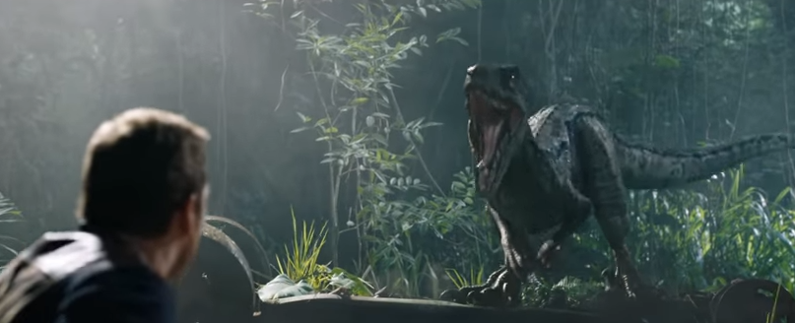
Film
Film: Two primary types of films are created in the 3D animation realm:
Visual effects films
Visual effects films are typically shot with real actors, but the backgrounds or other effects are computer generated.
Adapted from Andy Beane: 3D animation essentials 2012 by John Wiley & Sons, Inc.,

Slide 13
Fully animated Films
The film industry is one of the largest industries using 3D animation.
These films typically take about six months to four years to complete, depending on the scale of the project.
The production crew can range from 3 people to 300, again depending on the scale of the overall film.
Fully animated full-length films can take two to four years to create and have a very large crew of hundreds of employees.
Adapted from Andy Beane: 3D animation essentials 2012 by John Wiley & Sons, Inc.,

Slide 14
Fully animated Films
One studio usually completes the whole film internally.
Short films (those shorter than 40 minutes) often are created by individuals or small studios.
These films can be completed in a few months with a large crew or may take years depending on the artists’ work schedules.
Adapted from Andy Beane: 3D animation essentials 2012 by John Wiley & Sons, Inc.,

Slide 15
Visual effects films
Visual effects films are different from fully animated feature films in that they are shot by a regular movie crew.
A visual effects supervisor helps with camera work and with collecting any other data needed for the addition of the visual effects.
Then the completed shots are sent to visual effects studios to complete parts or the whole sequence of effects as needed.
Adapted from Andy Beane: 3D animation essentials 2012 by John Wiley & Sons, Inc.,

Slide 16
Television
Creating a single 3D animated television show is quite expensive and time-consuming.
Still, several of today’s shows are being created with 3D software, including South Park, Mickey Mouse Clubhouse, and Star Wars: The Clone Wars.
A more common usage of 3D animation in television is the addition of 3D visualizations to regular shows on networks such as the Discovery Health Channel, History Channel, and Science Channel.
Adapted from Andy Beane: 3D animation essentials 2012 by John Wiley & Sons, Inc.,

Slide 17
Video games
There are two primary fields in the video game industry:
3D animation
game cinematics
Video games created for smart phones and tablets typically take a few months to develop.
A large triple-A title such as Gears of War or Crysis might take 2 to 4 years to create.
Adapted from Andy Beane: 3D animation essentials 2012 by John Wiley & Sons, Inc.,

Slide 18
Advertising
The advertising industry is all about very short animations.
Typically, only 10 seconds to 4 or 5 minutes is needed to show or describe a product or service.
These short animations must be able to provide a great deal of information in this brief time span.
Adapted from Andy Beane: 3D animation essentials 2012 by John Wiley & Sons, Inc.,

Slide 19
Scientific
The scientific industries utilizing 3D animation include :
medicine,
law,
architecture,
and product visualization.
Adapted from Andy Beane: 3D animation essentials 2012 by John Wiley & Sons, Inc.,

Slide 20
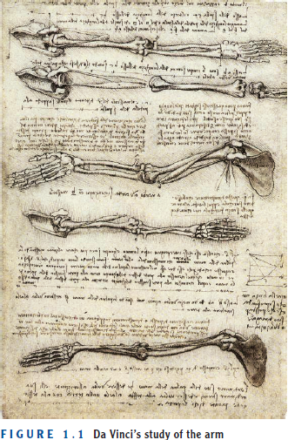
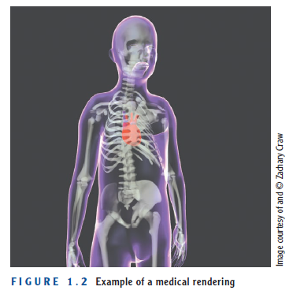
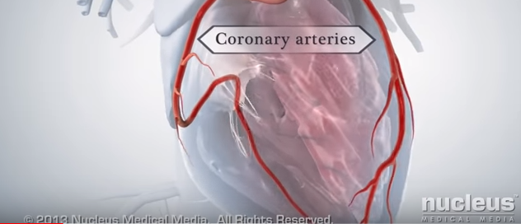
Medicine
The medical industry uses 3D animation in many ways, from creating a visualization of a specific medical event to depicting a biological reaction.
For example, you can demonstrate what happens when plaque will build up in your arteries and will block blood flow to the heart, causing a heart attack.
video medicine
Adapted from Andy Beane: 3D animation essentials 2012 by John Wiley & Sons, Inc.,

Slide 21
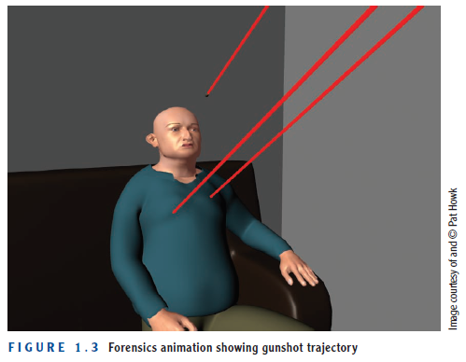
law
Law animation falls into two fields:
Forensics
Accident reconstruction And simulation.
Adapted from Andy Beane: 3D animation essentials 2012 by John Wiley & Sons, Inc.,

Slide 22
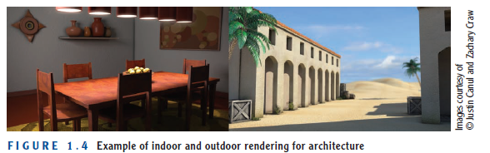
Architecture
Architects have been using computer-aided design (CAD) software since the 1980s to help them create better and more stable designs.
Today architects use 3D software in conjunction with CAD programs not only to create models.
Software such as Autodesk AutoCAD and Autodesk Revit enable architects to test the stability of designs under certain conditions.
Adapted from Andy Beane: 3D animation essentials 2012 by John Wiley & Sons, Inc.,

Slide 23

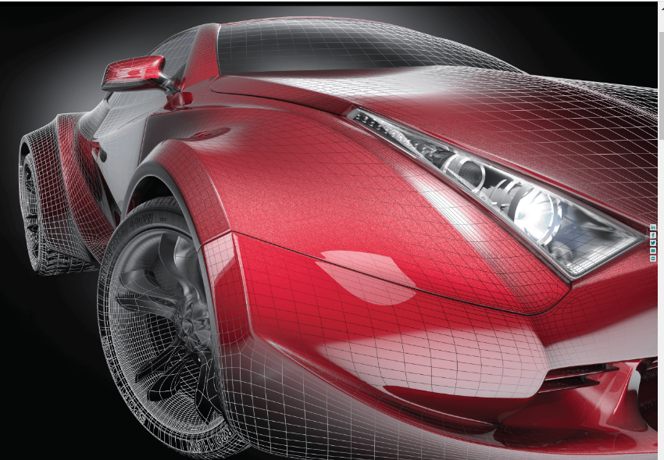

Product Visualization
This is similar to architectural rendering in that products can be designed and tested in 3D software and then rendered to show investors.
After the design is drawn up, a 3D artist will create a 3D model of the product in 3D design software to test its construction.
Then a visualization animation will be created to show how the product will work and how it is assembled if needed.
Adapted from Andy Beane: 3D animation essentials 2012 by John Wiley & Sons, Inc.,

Slide 24
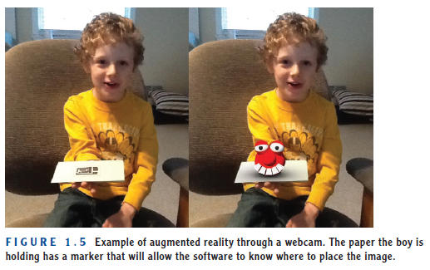
Other
Augmented reality might be considered by some as an advertising form of 3D animation, but because it is so new, it is premature to lump it into a certain field.
In augmented reality, a user looks at the real world and sees 3D elements added to it.
video augmented reality 1
video augmented reality 2
Adapted from Andy Beane: 3D animation essentials 2012 by John Wiley & Sons, Inc.,

Slide 25
The History of 3D Animation
1971-
1st 2D key frame animation software short movie
1973-
1st 2D raster graphics to represent point-of-view
1977-
First use of an animated 3D wire-frame graphic
1981-
First Computer-generated imagery (CGI) human character, Cindy. 1st to use modern shading
1982-
First film to use Particle Effects
1982-
15 min of full CGI animation, light cycle
1984-
Uses CGI for all space ship shots, replaces traditional models
1985-
Lucas film creates 1st photo-realistic character
1986-
1st realistic CGI animal

Slide 26
The History of 3D Animation
1988-
1st photo realistic use of morphing effect in a feature film
1989-
1st digital water effect
1990-
Use of motion capture for CGI characters
1993-
First photo realistic creatures
1995-
First CGI feature length film
2001-
1st film to use “off the shelf” software
2001-
1st use of AI (artificial Intelligence) for actors
2004-
1st film to use motion capture for all actors
2009-
1st film to use photo realistic characters in a fully CG 3D world

Slide 27
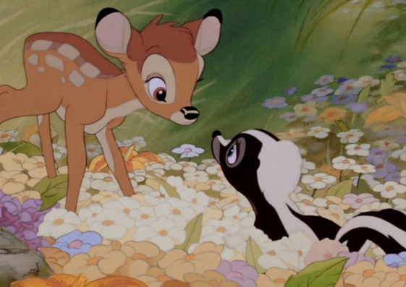
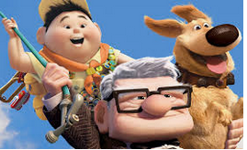
2D Animation vs. 3D Animation: definition
2D Animation: A figures are created or edited on the computer using 2D bitmap graphics or created and edited using 2D vector graphics.
3D Animation: is digitally modeled and manipulated by an animator. The animator usually starts by creating a 3D polygon mesh to manipulate.

Slide 28
2D Animation vs. 3D Animation: tools
2D Animation tools examples:
Synfig
Toon Boom Studio
Adobe Flash
Creatoon
Pencil
3D Animation tools examples :
3ds Max
Maya
Motionbuilder
Blender
Cinema 4D

Slide 29
The End

